Slide 1

Session-3

Slide 2
Content
StackLayout
AbsoluteLayout
RelativeLayout
Grid
ContentView
ScrollView
Frame

Slide 3
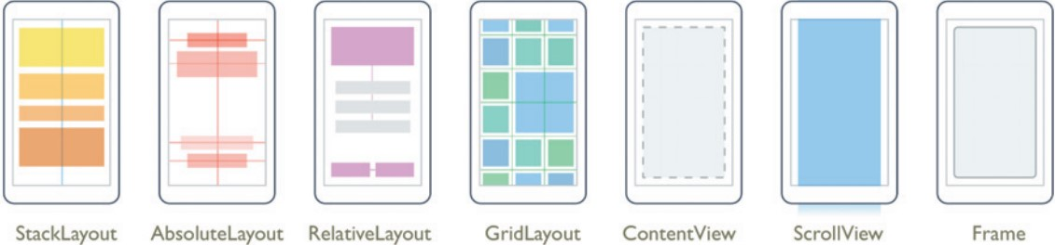

Slide 4
StackLayout
StackLayout organizes views in a one-dimensional line ("stack"), either horizontally or vertically
Positioning is determined by the order views were added to the layout
It is less complex than other views

Slide 5
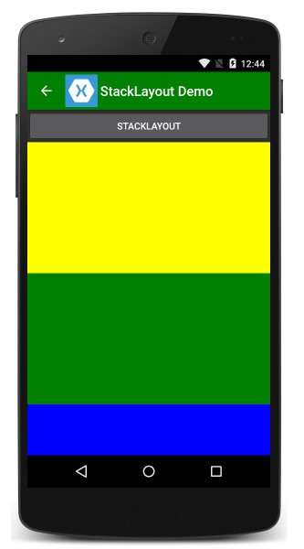
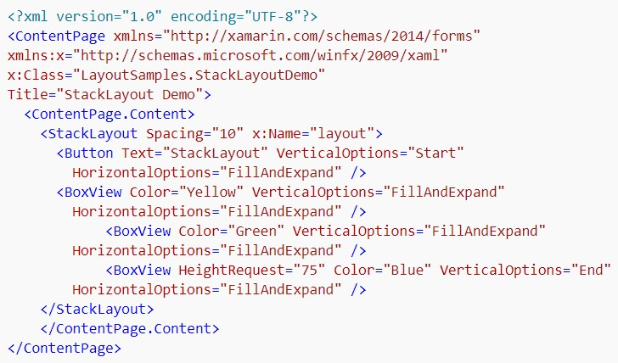

Slide 6
AbsoluteLayout
AbsoluteLayout positions and sizes child elements proportional to its own size and position or by absolute values.
Child views may be positioned and sized using proportional values or static values, and proportional and static values can be mixed.
Specifying Values
Views within an Absolute Layout are positioned using four values:
X – the x (horizontal) position of the view's anchor
Y – the y (vertical) position of the view's anchor
Width – the width of the view
Height – the height of the view

Slide 7
AbsoluteLayoutFlags
None – interprets all values as absolute. This is the default value if no layout flags are specified.
All – interprets all values as proportional.
WidthProportional – interprets the Width value as proportional and all other values as absolute.
HeightProportional – interprets only the height value as proportional with all other values absolute.
XProportional – interprets the X value as proportional, while treating all other values as absolute.
YProportional – interprets the Y value as proportional, while treating all other values as absolute.
PositionProportional – interprets the X and Y values as proportional, while the size values are interpreted as absolute.
SizeProportional – interprets the Width and Height values as proportional while the position values are absolute.

Slide 8
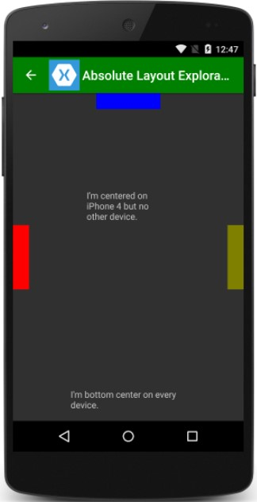
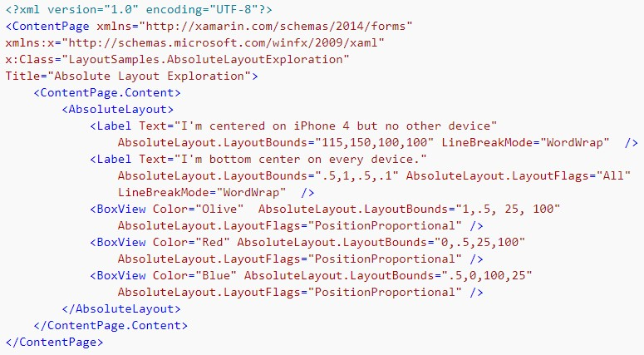

Slide 9
Relative Layout
Relative Layout is used to position and size views relative to properties of the layout or sibling views
Relative Layout does not have the concept of the moving anchor and does not have facilities for positioning elements relative to the bottom or right edges of the layout.
Relative Layout does support positioning elements outside of its own bounds.
Constraints
Positioning and sizing a view within a Relative Layout is done with constraints. A constraint expression can include the following information:
Type – whether the constraint is relative to the parent or to another view.
Property – which property to use as the basis for the constraint.
Factor – the factor to apply to the property value.
Constant – the value to use as an offset of the value.
ElementName – the name of the view that the constraint is relative to.

Slide 10
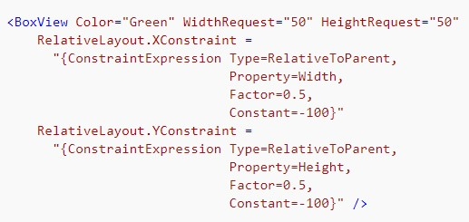
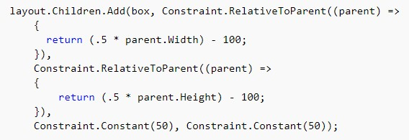
Xaml
C#

Slide 11
Grid
Grid supports arranging views into rows and columns.
Rows and columns can be set to have proportional sizes or absolute sizes.
The Grid layout should not be confused with traditional tables and is not intended to present tabular data.
Grid does not have the concept of row, column or cell formatting. Unlike HTML tables, Grid is purely intended for laying out content.

Slide 12
Rows and Columns
Row and column information is stored in Grid's RowDefinitions & ColumnDefinitions properties, which are each collections of RowDefinition and ColumnDefinition objects, respectively.
RowDefinition has a single property, Height, and ColumnDefinition has a single property, Width. The options for height and width are as follows:
Auto – automatically sizes to fit content in the row or column. Specified as GridUnitType.Auto in C# or as Auto in XAML.
Proportional(*) – sizes columns and rows as a proportion of the remaining space. Specified as a value and GridUnitType.Star in C# and as #* in XAML, with # being your desired value. Specifying one row/column with * will cause it to fill the available space.
Absolute – sizes columns and rows with specific, fixed height and width values. Specified as a value and GridUnitType.Absolute in C# and as # in XAML, with # being your desired value.

Slide 13
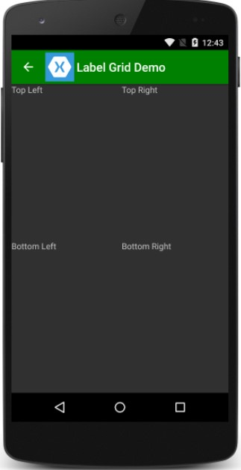
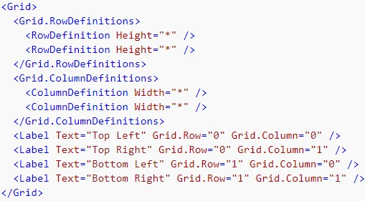
Xaml

Slide 14
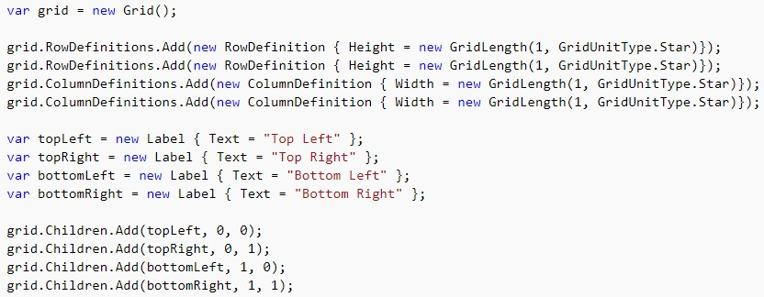
C#

Slide 15
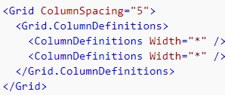
Spacing
Grid has properties to control spacing between rows and columns. The following properties are available for customizing the Grid :
ColumnSpacing – the amount of space between columns.
RowSpacing – the amount of space between rows.
Xaml
C#

Slide 16
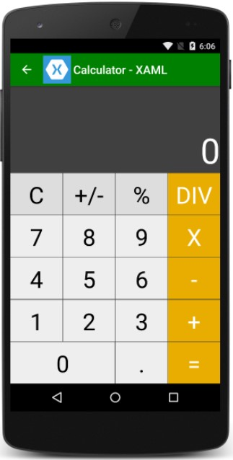

Spans
C#
Xaml

Slide 17
ContentView
ContentView contains a single child that is set with the Content property.
The Content property can be set to any View derivative, including other Layout derivatives.
ContentView is mostly used as a structural element and serves as a base class to Frame.

Slide 18
ScrollView
ScrollView contains layouts and enables them to scroll offscreen.
ScrollView is also used to allow views to automatically move to the visible portion of the screen when the keyboard is showing.
ScrollView has the following properties:
Content – gets or sets the view to display in the ScrollView.
ContentSize – read-only, gets the size of the content, which has a width and height component. This is a bindable property
Orientation – This is a ScrollOrientation, which is an enumeration that can be set to Horizontal, Vertical, or Both.
ScrollX – read-only, gets the current scroll position in the X dimension.
ScrollY – read-only, gets the current scroll position in the Y dimension.

Slide 19
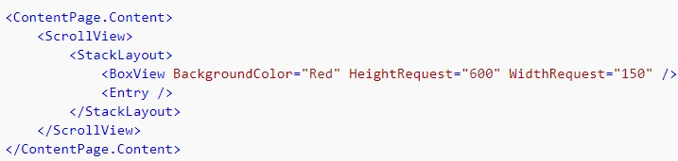
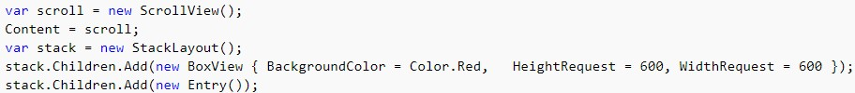
Xaml
C#

Slide 20
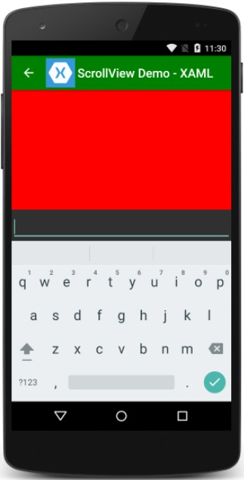

Slide 21
Methods
When scrolling to a particular element, the ScrollToPosition enumeration specifies where in the view the element will appear:
Center – scrolls the element to the center of the visible portion of the view.
End – scrolls the element to the end of the visible portion of the view.
MakeVisible – scrolls the element so that it is visible within the view.
Start – scrolls the element to the start of the visible portion of the view.

Slide 22
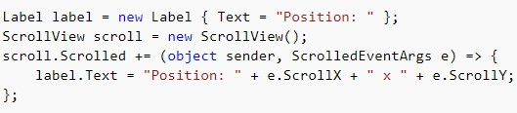
Events
ScrollView exposes just one event, Scrolled.
Scrolled is raised when the view has finished scrolling.
The event handler for Scrolled takes ScrolledEventArgs, which has the ScrollX and ScrollY properties.

Slide 23
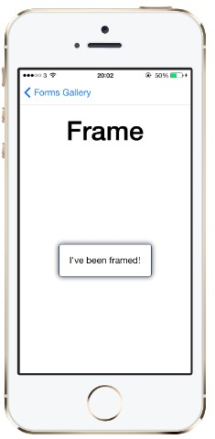
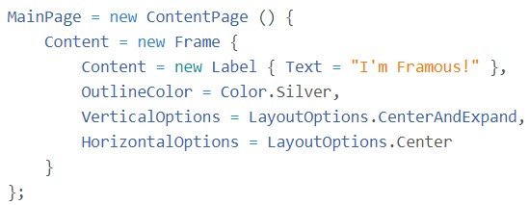
Frame
An element containing a single child, with some framing options.

Slide 24
Property
HasShadow - true or false, to indicate whether to show a shadow effect where the platform supports it.
OutlineColor - A color specification, with or without the prefix, "Color". For example, "Color.Red" and "Red" both specify the color red.
CornerRadius - Gets or sets the corner radius of the frame.

